Slide 1
Session 2
A Guide to Advanced Java
java.lang Package

Slide 2
Review
Thread is the smallest unit of executable code in an application that performs a particular job or task
Thread States: new state, runable,waiting, blocked and terminated.
Methods of Thread class: start(), sleep(), interrup()… and using method isAlive() and join()
Daemon Threads run continuously to perform a service, whithout having any connection with the overall state of the program.
Create by faculty ChungLD
A Guide to Advanced Java
<number>/28

Slide 3
Review…
Multiple threading performs two or more tasks at the same time
Thread Synchronization allows only one thread at a time to access the code
Wait-notify mechanism
Deadlocks describes a situation where two or more threads are blocked forever, waiting for the others to release a resource.

Slide 4
Objectives
Introduction Package
Introduction to java.lang package
Wrapper class
Other classes
Introduction to Reflection API
Examining classes
Manipulating objects
Working with Arrays
A Guide to Advanced Java
<number>/45

Slide 5
Code libraries
A library comprises a group of related files.
  For example: a math library will contain functions or subroutines that are used in mathematical calculations.
The basic idea behind using a code library is to sort out files or functions based on their functionality.
Using these predefined codes saves a lot of coding time.
In C libraries are known as header files, in C++ as class libraries and in Java as packages.

Slide 6
Creating packages in Java
In Java, a package is a combination of classes, interfaces and sub-packages.
  For example: java.util package has a sub-package called Scanner.
A package in Java can be created by including a package statement as the first statement in a Java program.
Syntax to define a package is:
  package <pkgname>;

Slide 7
Introduction to java.lang Package
In java programming language all the programs automatically import the java.lang package.
The java.lang package contains:
  Primitive data types
  Classes pertaining to strings, string buffers, exception and threads
  Classes that contain complex mathermatical
  The System class that contain the input and output streams for the standard input and output devices
  The Object class, which is the root of the class hierarchy
  The class named class, instances of which represent classes at runtime.
A Guide to Advanced Java
<number>/45

Slide 8
Use of the “java.lang” Package
The java.lang package contains classes that are useful for the design of Java programming language API. This package is used for:
  Creating multithreaded programs
  Creating mathematical and scientific applications
  Implementing security policies and runtime permissions for applications
  Creating application involving high volume of string and text manipulations
  Managing methods and properties of objects at runtime
  Creating application involving primitive data type manipulations
A Guide to Advanced Java
<number>/45

Slide 9
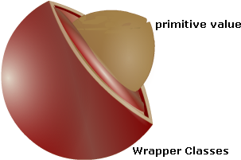
Wrapper Classes
Wrapper class are used to manage primitive values as objects. Wrapper are defined in the java.lang package.The wrapper class are required to
  Compare values in objects
  Convert values from one data type to another
  Check the data type of a value
A Guide to Advanced Java
<number>/45
A Guide to Advanced Java

Slide 10
Types of Wrapper Classes
Character : Character(ch)
Integer: Interger(i_number), Integer (str)
Short: Short(s_number), Short(str)
Byte: Byte(b_number), Byte(str)
Long: Long(l_number), Long(str)
Float: Float(f_number), Float(d_number), Float(str)
Double: Double(d_number), Double(str)
A Guide to Advanced Java
<number>/45
A Guide to Advanced Java

Slide 11
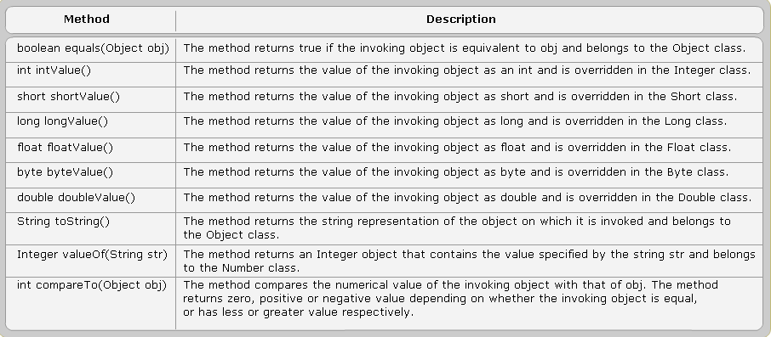
Methods of Wrapper Classes
A Guide to Advanced Java
<number>/45
A Guide to Advanced Java

Slide 12
Other Classes in “java.lang”
Math class: The Math class defines methods for basic numeric operations as well trigonometric functions. All the methods of this class are static. This is a final class and hence cannot be instantiated. The two mathematical constants present in this class are E and PI
Methods of the Math class
  pow(double x,double y)
  exp(double d)
  log(double x)
A Guide to Advanced Java

Slide 13
Methods of Math class
Trigonometric Functions
  sin(double num)
  cos(double num)
  tan(double num)
Arithmetic Functions
  ceil(double num)
  floor(double num)
  round(double num)
  random()
  sqrt(double num)
Example
A Guide to Advanced Java
<number>/45

Slide 14
“System” class
The System class provides the user with the standard input, output and error streams.
Standard input and output devices
  A stream to read from the standard input device (references by System.in)
  A stream to write to the standard output device ( references by System.out)
  A stream to write to the standard error device (references by System.error)
A Guide to Advanced Java
<number>/45

Slide 15
Getting enviroment properties
Keywords
  file.separator
  java.class.path
  java.class.version
  java.home
Example
  System.getProperty(“java.class.path”)
A Guide to Advanced Java
<number>/45

Slide 16
“Object” class
The Object class is the superclass of all classes. Even if a user-defined class does not extend any onther class. Some of the methods of the Object class are:
  equale(Object obj)
  finalize() throws Throwable
  notify()
  notifyAll()
  toString()
  wait() throws InterruptedException
Example
  String name=“Aptech”;
  if(name.equals(“Aptech”)
  System.out.println(“Yes, Aptech is the right choice!”);
A Guide to Advanced Java
<number>/45

Slide 17
“Runtime” class
The Runtime class encasulates the runtime enviroment. This class is used for memory management and executing additional processes. Every Java program has a single instance of this class to allow the application to communicate with the enviroment.
Some of the methods of this class are:
  exit(int code)
  freeMemory() returns the amount of free memory
  maxMemory() returns max memory JVM will try to use
  getRuntime() returns the current runtime instance associated with the Java application
  gc() method invodes the garbage collector.
  exec(String command) method executes the command specifies as an argument in a separate process
  availableProcessors() returns the number of processor available to JVM
A Guide to Advanced Java
<number>/45

Slide 18
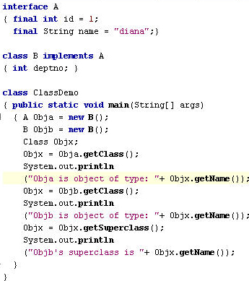
“Class” class
Instances of the Class class encapsulate the runtime state of an object in a running Java application. This allows retrieving information about the object during runtime.
A Guide to Advanced Java
<number>/45

Slide 19
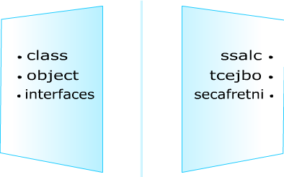
Reflection API
Reflection is the ability of classes, objects and interfaces to find information about itself. It allows a piece of code viewing its own classes and objects and also knowing the structure. Reflection also retrieves the constructors, methods and fields concerned with a class.
A Guide to Advanced Java
<number>/28

Slide 20
Uses of Reflection API
Analysing Classes
Controlling Objects
Controlling with Arrays

Slide 21
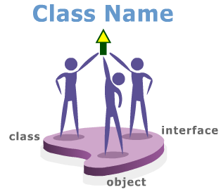
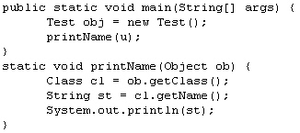
Analysing Classes>>Retrieveing Class Name
Every class in Java programming language has its individual class name.
A Guide to Advanced Java
<number>/28

Slide 22
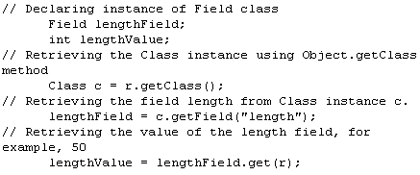
Retrieving Fields
A field of a class is retrieved by invoking the getField() method on class object.

Slide 23
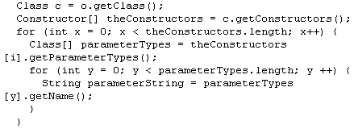
Retrieving Class Constructors
Constructors are invoked to create an instance of a class. By invoking the getConstructors() method.
A Guide to Advanced Java
<number>/28

Slide 24
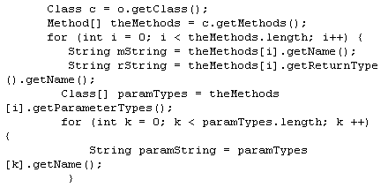
Method Information
The getMethods() method is invoked in a program to get the information about the public class to which the specified class belongs.
A Guide to Advanced Java
<number>/28

Slide 25
2-Arrays at Runtime
The Array class is used to dynamically create and access arrays at runtime. Class.isArray() method is used to check whether a particular object is an array. Array objects and classes can be accessed by Array class. New array objects can be instantiated and array elements can be accessed and modified using methods associated with Class.isArray()
A Guide to Advanced Java
<number>/28

Slide 26

Working with Objects
Default Constructors
  The reflection API allows creating an object whose class is unknown until runtime. The newInstance() method is invoked on a class instance to create an object with the no-argument constructor.
A Guide to Advanced Java
<number>/28

Slide 27
Parameterised Constructors
The newInstance() method is invoked on a Contructor object to create an object with a parameterised constructor.
A Guide to Advanced Java
<number>/28

Slide 28
Retrieving Field Values
Creating a Class object
Creating a Field object by invoking the getFiled() method on the Class object
Invoking one of the get() method on the Field instance
A Guide to Advanced Java
<number>/28

Slide 29
Assigning Field Values
Creating a Class object
Creating a Field object by invoking the getField() method on the Class object
Invoking one of the set() methods on the Field instance
A Guide to Advanced Java
<number>/28

Slide 30
get() Method
When an array name is unknown at compile time the getter methods of Array class can be used to access any array element, primitive data type or object of it.
A Guide to Advanced Java
<number>/28

Slide 31
set() Methods
When an array name is unknown at compile time the setter methods of Array class can be used to access any array element, primitive data type or object of it.

Slide 32
Summary
java.lang package are automatic imported in any program java. Java.lang contains string, string buffer, exception…
Wrapper class are used to manage primitive values as objects. Wrapper are defined in the java.lang package.
Other classes: Math, System, Object class…
Reflection API Reflection is the ability of classes, objects and interfaces to find information about itself.
Working with Arrays: New array objects can be instantiated and array elements can be accessed and modified using methods associated with Class.isArray()

Slide 33

Summary and Workshop
A Guide to Advanced Java
<number>/45

